Slide 1
Objective: Student will be able to understand that a function is a rule that assigns to each input exactly one output.
Bell Work
Write the following numbers in standard form:
$2.104×{10}^{4}$
$3.041 ×{10}^{−3}$

Slide 2
Unit: Functions Topic: Identifying Functions

Slide 3
FUNCTIONS:
How does the vending machine function?
What would you consider an “input”
Is each input unique? Explain
What would you consider an “output”
What situation(s) may signal that the machine is NOT functioning correctly?

Slide 4
Relation: A set of ordered pairs
Function: A rule that assigns each input to exactly one out
Domain: x values - INPUT
Range: y values - OUTPUT

Slide 5
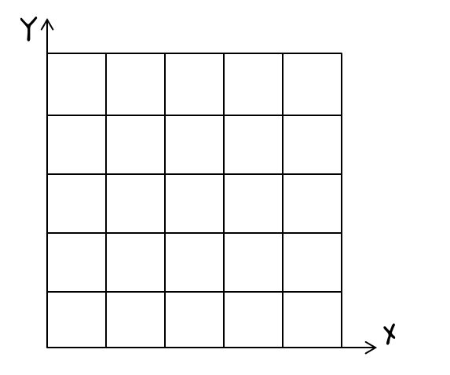
Is the relation (3, 5), (2, 1), (1, 4), and (5,5) a function?
Mapping:
Graph:
1
2
3
5
1
4
5
FUNCTION: Each input has exactly one output, vertical line passes through only one point at a time.

Slide 6
Is the relation (1, 1), (2, 3), (3, 4), (4, 5), and (3, 0) a function?
Mapping:
Graph:
0
1
3
4
5
1
2
3
4
Not a Function – 3 does not have exactly one output it has outs of 0 and 4

Slide 7
How can you tell if a graph represents a function?
Function
Not a
Function
Function
Not a
Function

Slide 8
How can you tell if values in a table represent a function?
X | Y
-4 | 6
-3 | 6
3 | 2
4 | 2
5 | 2
X | Y
0 | 6
1 | 2
3 | 1
5 | 5
7 | 0
X | Y
3 | 1
3 | 2
6 | 3
9 | 4
12 | 5
Function
Function
Not a
Function

Slide 9
Summary: A relationship is a function if each input assigns to exactly one output. You can quickly look at a graph and use the vertical line test and also look at a table or map to make sure no x values repeat.

